Slide 1
/Nithya/English/school

Slide 2
/Nithya/English/school

Slide 5
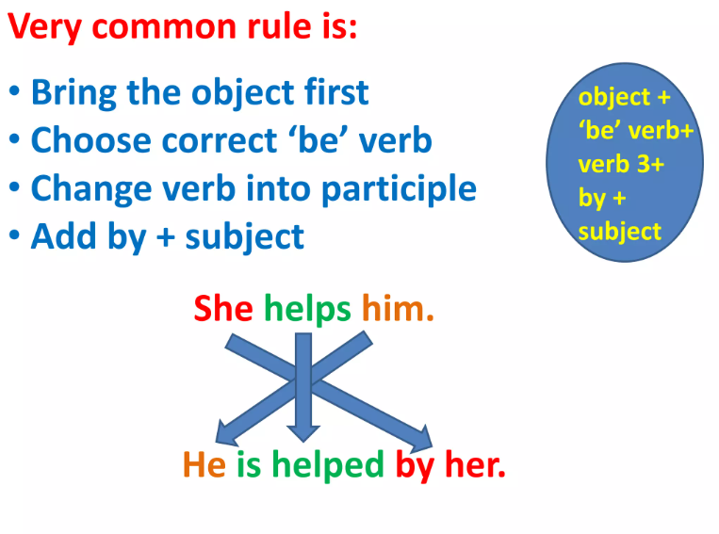
/Nithya/English/school

Slide 14
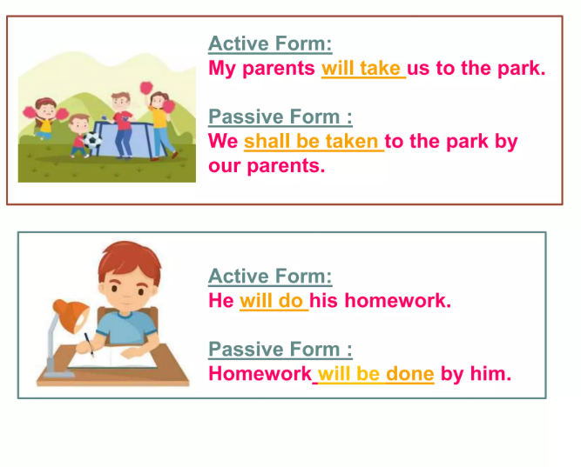

Slide 15
